Slide 1
Arkana - Grounded AI for Historical and Cultural Exploration
Specialization Project Presentation
By
Abhishek Singh (2547103), Arjit Singhal (2547113), Nilesh Gupta(2547138)
Project Guide
Dr. Kavitha R
Department of Computer Science
CHRIST(Deemed to be University), Bengaluru-29

Slide 2
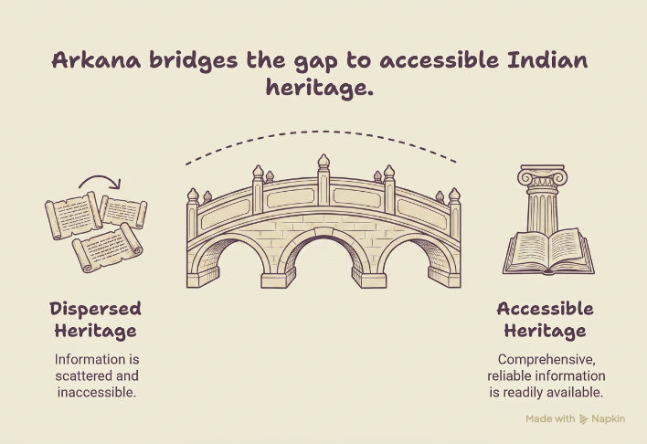
Introduction
Arkana is an AI-powered Retrieval-Augmented Generation (RAG) platform designed to make India's vast historical, cultural, and architectural heritage accessible through accurate, citation-backed conversations and an interactive geographic atlas.
India is home to more than 37,000 documented monuments and heritage sites, along with thousands of traditional art forms, archaeological records, museum collections, and historical manuscripts.
However, this information is dispersed across numerous repositories, including government archives, museum collections, with each source varying in structure, completeness, and accessibility.
As a result, obtaining comprehensive and reliable information often requires consulting multiple independent resources, making heritage exploration difficult for researchers, students, and the general public.

Slide 3
Analysis Phase
Study of Existing System: Existing platforms (ASI website, Wikipedia, Google Arts & Culture) offer fragmented, unverified information about Indian heritage sites. None provide grounded, citation-backed conversational access. AI systems like ChatGPT hallucinate heritage facts without citing verified sources.
Limitations of Existing System: No citation-grounded answers; information scattered across 37,000+ sites; no geographic atlas integration; no natural-language query support; AI hallucination without verified retrieval; no machine-readable unified knowledge base.
Features of Proposed System: RAG-powered conversational Q&A with source citations; interactive Leaflet.js heritage atlas; unified data from Wikidata, Wikipedia, UNESCO, OSM; semantic chunking and hybrid vector + FTS retrieval; image-based artifact identification via CLIP; grounded LLM responses.
Functional Requirements: Natural language Q&A on heritage sites; geographic map exploration; citation-linked answers; image-based artifact search; multi-source data ingestion (Wikidata, Wikipedia, UNESCO, OSM); streamed LLM responses.
Non-Functional Requirements: RAG retrieval latency p50 < 4 seconds; supports ~37,000 heritage site records; open-licensed data only (CC BY-SA, CC0, ODbL); scalable containerised deployment (Docker); retrieval precision >85% on golden test set; zero hallucination guarantee via citation grounding.

Slide 4
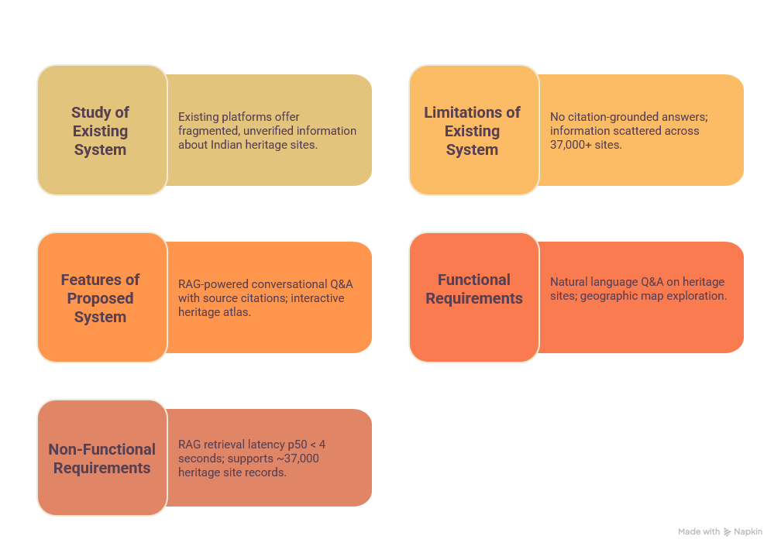

Slide 5
Goal
The primary goal of Arkana is to develop a publicly accessible AI-powered platform that enables users to explore India's rich historical and cultural heritage through natural-language conversations.
Instead of requiring users to manually search across multiple websites and archives, the platform allows them to ask questions about monuments, heritage sites, traditional art forms, and cultural practices in plain language.
Using a Retrieval-Augmented Generation (RAG) architecture, Arkana retrieves relevant information from verified sources such as Wikipedia, Wikidata, UNESCO, and OpenStreetMap (OSM) before generating a response. Every answer is accompanied by citations, ensuring transparency, traceability, and factual accuracy.
The platform also integrates an interactive geographic atlas, allowing users to visually explore heritage locations and discover related cultural information.
Ultimately, Arkana aims to make India's heritage more accessible, trustworthy, and engaging for students, researchers, tourists, and the general public.

Slide 6
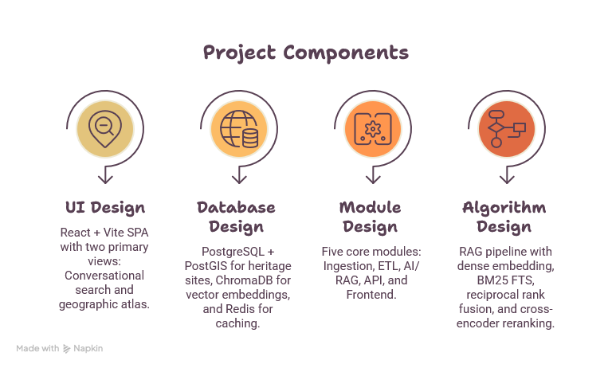
Design Phase
UI Design: React + Vite SPA with two primary views: (1) Conversational search interface with streamed LLM responses and inline source citations; (2) Interactive Leaflet.js geographic atlas with heritage site markers, filters by state/type, and site detail panels.
Database Design: PostgreSQL + PostGIS: heritage_sites table with geography columns, GiST spatial index, and FTS index. ChromaDB (MVP vector store) for semantic embeddings. Redis for caching. Pydantic v2 HeritageSite as the canonical data schema across all sources.
Module Design: 5 core modules: (1) Ingestion - extractors for Wikidata, Wikipedia, UNESCO, OSM; (2) ETL - normalizer, deduplicator, enricher, chunker; (3) AI/RAG - embedding, hybrid retrieval (vector + BM25), reranking, Gemini LLM generation, NER; (4) API - FastAPI endpoints; (5) Frontend - React atlas + chat UI.
Algorithm Design: RAG Pipeline: Query → Dense embedding (all-mpnet-base-v2) + BM25 FTS → Reciprocal Rank Fusion (top-20 candidates) → Cross-encoder reranking (top 3–4 chunks) → Gemini LLM with citation-grounded prompt → SSE streamed response. Deduplication: QID exact-match + RapidFuzz fuzzy (threshold 90). CLIP zero-shot style classification for artifact images.

